Slide 1
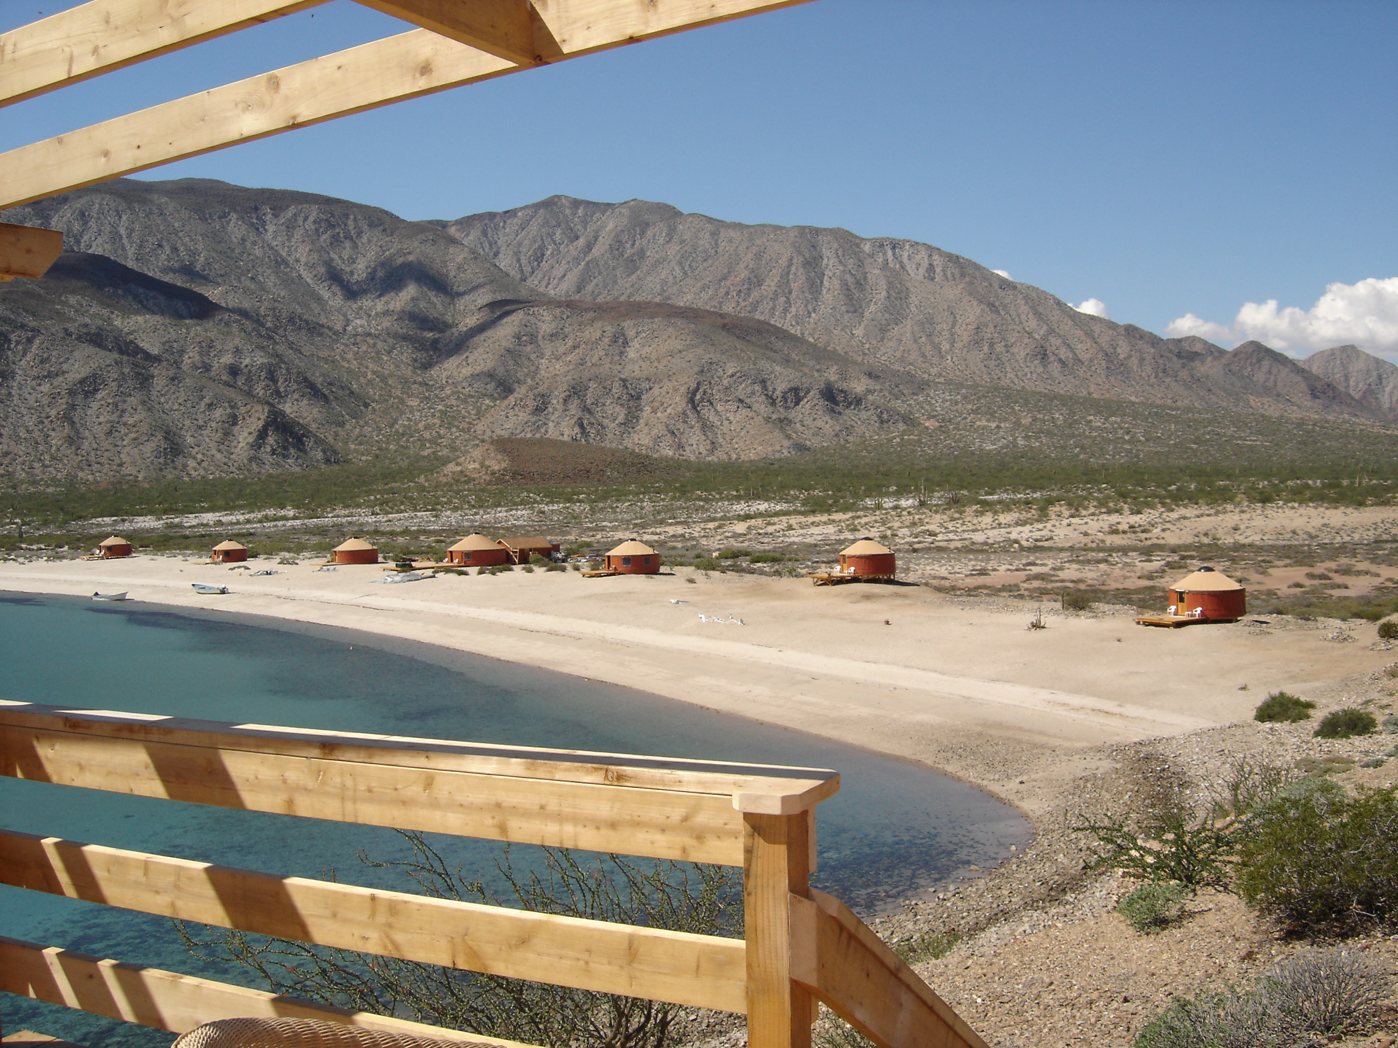
THE Tourism Business Success FORMULA
5 Surprising Ways To Boost Your Profits & Value of your Tourism Business
Tourism Tim Warren • 707-867-1496
TravelBusinessSuccesss.com
AdventureBizSuccess.com
Since ‘94, Tourism Business & Marketing Strategies to Help You
Plan, Start, Grow, Prosper and Exit Successfully

Slide 2
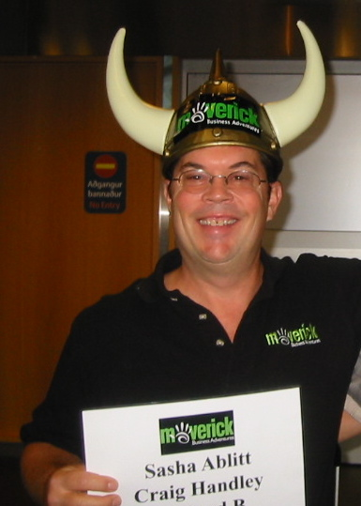
What you will gain when you watch and take action in this tourism business success workshop
dvwvwvswv
dvwvwvswv
dvwvwvswv
dvwvwvswv
TravelBusinessSuccesss.com
AdventureBizSuccess.com
Since ‘94, Tourism Business & Marketing Strategies to Help You
Plan, Start, Grow, Prosper and Exit Successfully
Tourism Tim Warren • 707-867-1496

Slide 3

“Tourism Tim” Warren’s Journey
Graduated high school, loved travel,
adventure and pursued International Business Degree
Worked in many industries. The common denominator: marketing, entrepreneurship, sales, customer service, adventure
Started helping brother’s Baja AirVentures surfing tour company in 1989 with little experience or money
This new tour business struggled at first. I knew we needed help…
Tourism Tim Warren • 707-867-1496
TravelBusinessSuccesss.com
AdventureBizSuccess.com
Since ‘94, Tourism Business & Marketing Strategies to Help You
Plan, Start, Grow, Prosper and Exit Successfully

Slide 4
Tourism Tim’s” Journey in the Tourism Industry
  Studied the success of many travel & hospitality professionals, applied it to Kevin’s business and things took off!
  Went to travel trade conferences, met people just like my brother.
  Started helping other adventure travel businesses in ‘94 grow
  Since 1994, have consulted, trained and managed projects for 100’s of tourism, travel & hospitality projects of all size all over the globe.
  Planning, Start-up, Sales, Marketing, Management, Operations, Growth, Exit Planning, Brokerage
TravelBusinessSuccesss.com
AdventureBizSuccess.com
Since ‘94, Tourism Business & Marketing Strategies to Help You
Plan, Start, Grow, Prosper and Exit Successfully
Tourism Tim Warren • 707-867-1496

Slide 5

THIS IS STEPHANIE
SHE SOLD HER
$2 MILLION IN PROFITS TOUR COMPANY…
…FOR $12 MILLION
TravelBusinessSuccesss.com
AdventureBizSuccess.com
Since ‘94, Tourism Business & Marketing Strategies to Help You
Plan, Start, Grow, Prosper and Exit Successfully
Tourism Tim Warren • 707-867-1496
Notes:
SPECIALIZES in educational nature trips serving academic and alumni communities from High school to advance degrees
Sold her company for 6 times earning ( EBITDA)
EBITDA is essentially net income with interest, taxes, depreciation and amortization added back to it. EBITDA can be used to analyze and compare profitability among companies and industries as it eliminates the effects of financing and accounting decisions.

Slide 6
Sold her company for 6 times (EBITDA)
EBITDA is essentially net income with interest, taxes, depreciation and amortization added back to it. EBITDA can be used to analyze and compare profitability among companies and industries as it eliminates the effects of financing and accounting decisions.
TravelBusinessSuccesss.com
AdventureBizSuccess.com
Since ‘94, Tourism Business & Marketing Strategies to Help You
Plan, Start, Grow, Prosper and Exit Successfully
Tourism Tim Warren • 707-867-1496
Notes:
SPECIALIZES in educational nature trips serving academic and alumni communities from High school to advance degrees
Sold her company for 6 times earning ( EBITDA)
EBITDA is essentially net income with interest, taxes, depreciation and amortization added back to it. EBITDA can be used to analyze and compare profitability among companies and industries as it eliminates the effects of financing and accounting decisions.

Slide 7
Company Value Builder Score
By Offer Multiple
“What multiple of your earnings did the offer represent?”
Comparing average multiple offered
TravelBusinessSuccesss.com
AdventureBizSuccess.com
Since ‘94, Tourism Business & Marketing Strategies to Help You
Plan, Start, Grow, Prosper and Exit Successfully
Tourism Tim Warren©2018
707-867-1496
Notes:
Value Builder Score
SEE BACK OF PRESENTATION FOR FREE ACCESS TO VB SURVEY AND REPORT ( $ 495 VALUE)©

Slide 8
Multiple Goes Up In Lock Step With Size
“What multiple of your earnings did the offer represent?”
Comparing average multiple offered
TravelBusinessSuccesss.com
AdventureBizSuccess.com
Since ‘94, Tourism Business & Marketing Strategies to Help You
Plan, Start, Grow, Prosper and Exit Successfully
Tourism Tim Warren©2018
707-867-1496

Slide 9
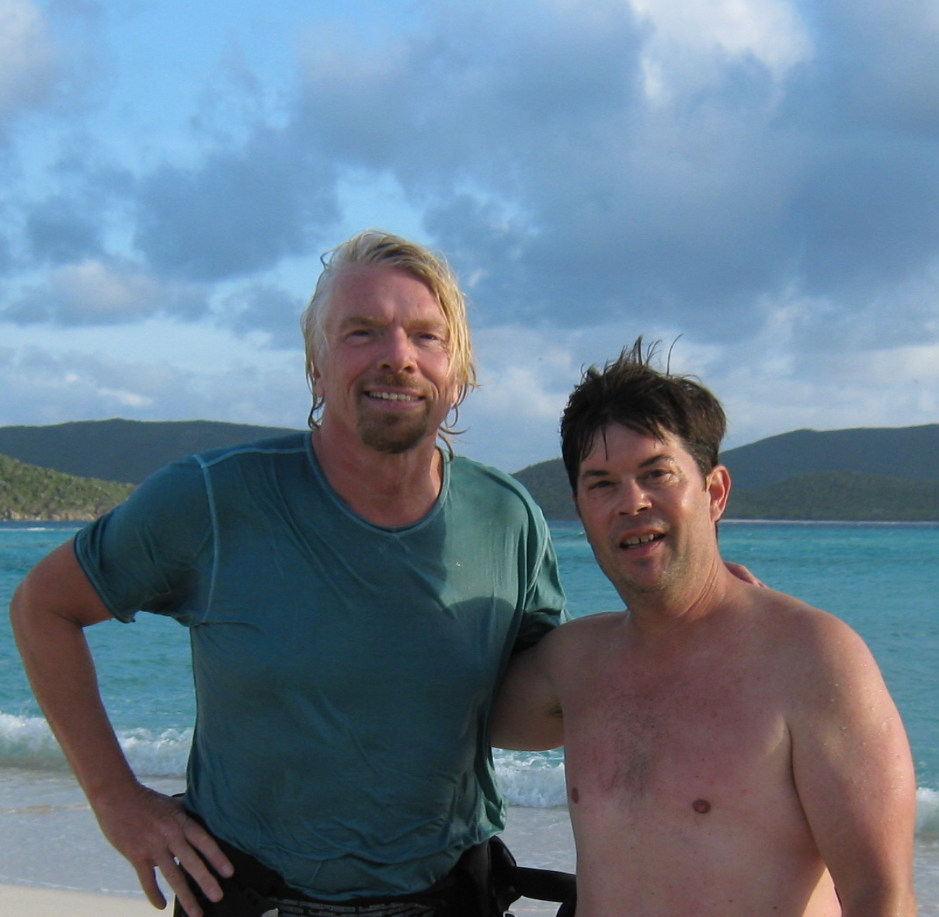

MONOPOLY CONTROL
TravelBusinessSuccesss.com
AdventureBizSuccess.com
Since ‘94, Tourism Business & Marketing Strategies to Help You
Plan, Start, Grow, Prosper and Exit Successfully
Tourism Tim Warren©2018
707-867-1496

Slide 10
Tour Companies With a Monopoly In Their Market Get 50% Higher Offers
“What multiple of your earnings did the offer represent?”
Comparing average multiple offered
TravelBusinessSuccesss.com
AdventureBizSuccess.com
Since ‘94, Tourism Business & Marketing Strategies to Help You
Plan, Start, Grow, Prosper and Exit Successfully
Tourism Tim Warren©2018
707-867-1496

Slide 11


SELL MORE TOURS TO STUDENTS
FIND MORE STUDENTS WITH A FREINDS
TravelBusinessSuccesss.com
AdventureBizSuccess.com
Since ‘94, Tourism Business & Marketing Strategies to Help You
Plan, Start, Grow, Prosper and Exit Successfully
Tourism Tim Warren©2018
707-867-1496

Slide 12

LESSON #1: SELL LESS TOURS TO MORE PEOPLE
TravelBusinessSuccesss.com
AdventureBizSuccess.com
Since ‘94, Tourism Business & Marketing Strategies to Help You
Plan, Start, Grow, Prosper and Exit Successfully
Tourism Tim Warren© 2018
707-867-1496

Slide 13
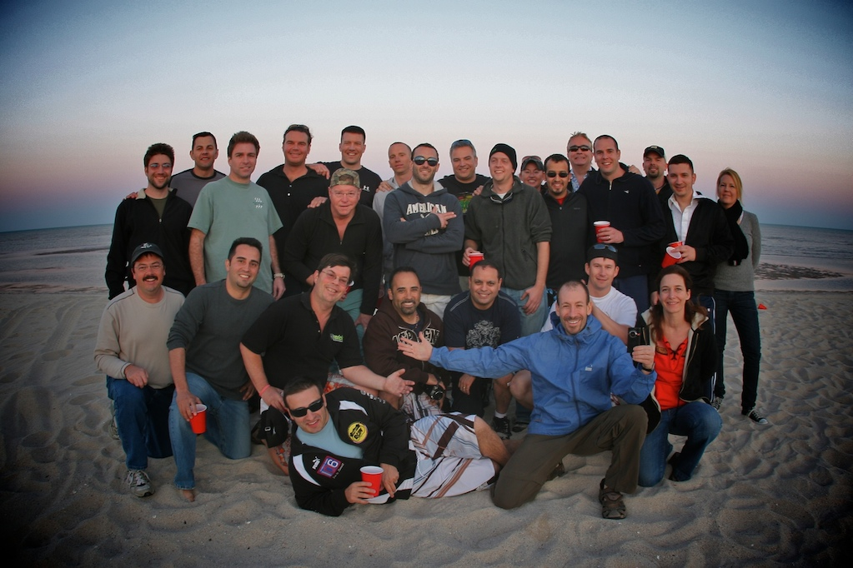
How Likely Are Your Guests To Recommend You?
TravelBusinessSuccesss.com
AdventureBizSuccess.com
Since ‘94, Tourism Business & Marketing Strategies to Help You
Plan, Start, Grow, Prosper and Exit Successfully
Tourism Tim Warren©2018
707-867-1496

Slide 14




Promoters Drive Value
Growth (indexed)
Years
Net Promoter® and NPS® are registered trademarks, and Net Promoter Score and Net Promoter System are trademarks of Bain & Company, Satmetrix Systems and Fred Reichheld. © 1996-2013. Bain & Company
TravelBusinessSuccesss.com
AdventureBizSuccess.com
Since ‘94, Tourism Business & Marketing Strategies to Help You
Plan, Start, Grow, Prosper and Exit Successfully
Tourism Tim Warren©2018
707-867-1496

Slide 15

Calculating Your Net Promoter Score
% of Promoters :
25%
70%
% of Passives :
5%
% of Detractors :
20%
Net Promoter Score :
TravelBusinessSuccesss.com
AdventureBizSuccess.com
Since ‘94, Tourism Business & Marketing Strategies to Help You
Plan, Start, Grow, Prosper and Exit Successfully
Tourism Tim Warren©2018
707-867-1496

Slide 16
ONBOARDING TEAM LED TO 78% NPS SCORE
TravelBusinessSuccesss.com
AdventureBizSuccess.com
Since ‘94, Tourism Business & Marketing Strategies to Help You
Plan, Start, Grow, Prosper and Exit Successfully
Tourism Tim Warren©2018
707-867-1496
Notes:
The importance of hiring
The importance of Training – Kelsey Tonner – Be a better guide
See TBS podcast #71

Slide 17

Lesson #2: Strive For 50% + Net Promoter Score
TravelBusinessSuccesss.com
AdventureBizSuccess.com
Since ‘94, Tourism Business & Marketing Strategies to Help You
Plan, Start, Grow, Prosper and Exit Successfully
Tourism Tim Warren©2018
707-867-1496

Slide 18
Companies With 75%+ Recurring Revenue Get Much Better Offers
“What multiple of your earnings did the offer represent?”
Comparing average multiple offered
TravelBusinessSuccesss.com
AdventureBizSuccess.com
Since ‘94, Tourism Business & Marketing Strategies to Help You
Plan, Start, Grow, Prosper and Exit Successfully
Tourism Tim Warren©2018
707-867-1496

Slide 19
$2 MILLION IN REVENUE: 100% RECURRING
TravelBusinessSuccesss.com
AdventureBizSuccess.com
Since ‘94, Tourism Business & Marketing Strategies to Help You
Plan, Start, Grow, Prosper and Exit Successfully
Tourism Tim Warren©2018
707-867-1496
Notes:
Serving academic markets
Every year they came back to do the same tours
Kept growing schools & alumni marketing for annual business
Students graduated and started bringing back fellow co-workers
Reputation was stellar in academic trade associations
Referral rates kept growing

Slide 20

Lesson #3: Create Recurring Revenue Streams
Copyright © 2017 Built to Sell Inc.
www.ValueBuilder.com
Notes:
Repeat business: Guest that keep coming back
- Dan Austin: Austin’s Adventures: 70% of business is repeat or referrals
Be excellent in your specialty: outdoor education, sea kayaking, soft eco-adventures, VIP travel
Serve niche markets - (Big fish in a small pond)
- Business, schools, associations, regional, singles, LGBT, families, Travel agents, Geographic
Kept focusing on your niche market for growth and domination
Alumni guests come back.
Referrals go up too ( there are specialty techniques to grow referrals)
Reputation was stellar in

Slide 21
Owner Of The Customer Relationship
“What multiple of your earnings did the offer represent?”
COMPARING AVERAGE MULTIPLE OFFERED
TravelBusinessSuccesss.com
AdventureBizSuccess.com
Since ‘94, Tourism Business & Marketing Strategies to Help You
Plan, Start, Grow, Prosper and Exit Successfully
Tourism Tim Warren©2018
707-867-1496

Slide 22

LARGEST CUSTOMER <1% OF REVENUE
TravelBusinessSuccesss.com
AdventureBizSuccess.com
Since ‘94, Tourism Business & Marketing Strategies to Help You
Plan, Start, Grow, Prosper and Exit Successfully
Tourism Tim Warren©2018
707-867-1496

Slide 23

Lesson #4: Reduce Reliance on Customers, Employees and Suppliers
TravelBusinessSuccesss.com
AdventureBizSuccess.com
Since ‘94, Tourism Business & Marketing Strategies to Help You
Plan, Start, Grow, Prosper and Exit Successfully
Tourism Tim Warren©2018
707-867-1496

Slide 24

GROWTH POTENTIAL
TravelBusinessSuccesss.com
AdventureBizSuccess.com
Since ‘94, Tourism Business & Marketing Strategies to Help You
Plan, Start, Grow, Prosper and Exit Successfully
Tourism Tim Warren©2018
707-867-1496

Slide 25
How Easy Would It Be
To Accommodate 5 X Demand?
COMPARING AVERAGE MULTIPLE OFFERED
TravelBusinessSuccesss.com
AdventureBizSuccess.com
Since ‘94, Tourism Business & Marketing Strategies to Help You
Plan, Start, Grow, Prosper and Exit Successfully
Tourism Tim Warren©2018
707-867-1496

Slide 26
GROWING AT 17%
PER YEAR
TravelBusinessSuccesss.com
AdventureBizSuccess.com
Since ‘94, Tourism Business & Marketing Strategies to Help You
Plan, Start, Grow, Prosper and Exit Successfully
Tourism Tim Warren©2018
707-867-1496

Slide 27


Lesson #5: Find An Acquirer you can help grow
TravelBusinessSuccesss.com
AdventureBizSuccess.com
Since ‘94, Tourism Business & Marketing Strategies to Help You
Plan, Start, Grow, Prosper and Exit Successfully
Tourism Tim Warren©2018
707-867-1496

Slide 28

Five Keys To A Lucrative Exit
SELL LESS STUFF TO MORE PEOPLE
CREATE RECURRING REVENUE STREAMS
FIND AN ACQUIRER YOU CAN HELP GROW
1
2
3
4
5
EXIT
$
STRIVE FOR 50% + NET PROMOTER SCORE
REDUCE RELIANCE
ON CUSTOMERS, EMPLOYEES & SUPPLIERS
TravelBusinessSuccesss.com
AdventureBizSuccess.com
Since ‘94, Tourism Business & Marketing Strategies to Help You
Plan, Start, Grow, Prosper and Exit Successfully
Tourism Tim Warren©2018
707-867-1496

Slide 29

Lesson #5: Find An Acquirer you can help grow

Slide 30
Lesson #5: Find An Acquirer you can help grow

Slide 31
Find Out if Your Tourism Website Will Be a Big Success or Doomed to Struggle
Tourism Website Success
25 Point Checklist
TinyURL.com/tourismwebsitechecklist

